Slide 1

Subject Code : SITA1502 Subject Name: CUSTOMER INTERFACE
DESIGN AND DEVELOPMENT
Prepared By: Dr. R. M. Gomathi/Dr. M. Malini Deepika

Slide 2

Unit – III Server Side Scripting

Slide 3
Introduction to Scripting Languages
All scripting languages are programming languages.
The scripting language is basically a language where instructions are written for a run time environment.
They do not require the compilation step and are rather interpreted. It brings new functions to applications and glue complex system together.
A scripting language is a programming language designed for integrating and communicating with other programming languages.
Eg. PHP, Node js, Ruby, Python, Perl etc.,

Slide 4
Differences Between Programming vs Scripting
Programming
Specific set of instructions that can be used to produce various kinds of output.
Compiled to machine code and run on the hardware of the underlying Operating system.
Eg. Java, Scala, C, C++, etc.
Scripting
Scripting languages are generally interpreted. A scripting language’s primary focus does not build the application but might provide behavior to an existing application.
It can manipulate, customize and automate the facilities of an existing system.
Eg. Javascript, Perl, VBScript, etc.,

Slide 5
Application of Scripting Languages
Scripting languages are used in web applications. It is used in server side as well as client side.
Client-side scripting languages are: JavaScript, VBScript, AJAX, jQuery etc.
Server-side scripting languages are: PHP, ASP.Net, Perl etc.
Scripting languages are used in system administration.
Eg: Shell, Perl, Python scripts etc.
It is used in Games application and Multimedia.
It is used to create plugins and extensions for existing applications.

Slide 6
PHP - Introduction
Acronym for "PHP: Hypertext Preprocessor“.
PHP was conceived sometime in the fall of 1994 by Rasmus Lerdorf.
PHP is a server-side scripting language that is embedded in HTML. It is used to manage dynamic content, databases, session tracking, even build entire e-commerce sites.
PHP is a powerful tool for making dynamic and interactive Web Pages.
It is integrated with a number of popular databases, including MySQL, PostgreSQL, Oracle, Sybase, Informix, and Microsoft SQL Server.
PHP Syntax is C-Like.
PHP scripts are executed on the server
PHP is free to download and use.
Currently, the latest stable version is PHP 8.0.

Slide 7
What Can PHP Do?
PHP can generate dynamic page content
PHP can create, open, read, write, delete, and close files on the server
PHP can collect form data
PHP can send and receive cookies
PHP can add, delete, modify data in your database
PHP can be used to control user-access and encrypt data
The user may output images, PDF files, and even Flash movies. You can also output any text, such as XHTML and XML.

Slide 8
Why PHP?
PHP runs on various platforms (Windows, Linux, Unix, Mac OS X, etc.)
PHP is compatible with almost all servers used today (Apache, IIS, etc.)
PHP supports a wide range of databases
PHP is free. Download it from the official PHP resource: www.php.net
PHP is loosely typed language

Slide 9
Example: - "Hello World" Script in PHP
<html>
<head>
<title>Hello World</title>
</head>
<body>
<?php echo "Hello, World!";?>
</body>
</html>
Output:
Hello, World!

Slide 10
Parser Recognised comments
All PHP code must be included inside one of the three special markup tags which are recognised by the PHP Parser.
<?php PHP code goes here ?>
<? PHP code goes here ?>
<script language = "php"> PHP code goes here </script>
A most common tag is the <?php...?>

Slide 11
PHP echo and print Statements
There are two basic ways to get the output in PHP:
echo
Print
Difference between echo and print
echo
echo is a statement, which is used to display the output.
echo can be used with or without parentheses.
echo does not return any value.
We can pass multiple strings separated by comma (,) in echo.
echo is faster than print statement.

Slide 12
print
print is also a statement, used as an alternative to echo at many times to display the output.
print can be used with or without parentheses.
print always returns an integer value, which is 1.
Using print, we cannot pass multiple arguments.
print is slower than echo statement.

Slide 13
For Example (Check multiple arguments)
You can pass multiple arguments separated by a comma (,) in echo. It will not generate any syntax error
<?php
$fname = "Gunjan";
$lname = "Garg";
echo "My name is: ".$fname,$lname;
?>
Output:
My name is: GunjanGarg
Note: print statement will generate a syntax error because of multiple arguments.

Slide 14
For Example (Check Return Value)
echo statement does not return any value. It will generate an error if you try to display its return value. But print returns a value, which is always 1
<?php
$lang = "PHP";
$ret = print $lang." is a web development language.";
print "</br>";
print "Value return by print statement: ".$ret;
?>
Output:
PHP is a web development language
Value return by print statement: 1

Slide 15
PHP Variables
Denoted with a leading dollar sign ($).
The value of a variable is the value of its most recent assignment.
Variables are assigned with the = operator, with the variable on the left-hand side and the expression to be evaluated on the right.
Variables can, but do not need, to be declared before assignment.
Variables in PHP do not have intrinsic types - a variable does not know in advance whether it will be used to store a number or a string of characters.
Variables used before they are assigned have default values.
PHP does a good job of automatically converting types from one to another when necessary.

Slide 16
PHP Data Types
PHP supports the following data types:
Integer
Float (floating point numbers - also called double)
Boolean
NULL
String
Array
Object
Resource

Slide 17
1. Integers
They are whole numbers, without a decimal point, like 4195. They are the simplest type .they correspond to simple whole numbers, both positive and negative. Integers can be assigned to variables, or they can be used in expressions as following,
$int_var = 12345;
$another_int = -12345 + 12345;
2. Doubles
They like 3.14159 or 49.1. By default, doubles print with the minimum number of decimal places needed. For example, the code −
<?php
$a = 2.2888800;
$b = 2.2111200;
$c = $a + $b;
print("$a + $b = $c <br>");
?>
Output:
2.28888 + 2.21112 = 4.5

Slide 18
2. Boolean
They have only two possible values either true or false. PHP provides a couple of constants especially for use as Booleans: TRUE and FALSE, which can be used like so −
if (TRUE)
print("This will always print<br>");
else
print("This will never print<br>");
Each of the following variables has the truth value embedded in its name when it is used in a Boolean context.
$true_num = 3 + 0.14159;
$true_str = "Tried and true"
$true_array[49] = "An array element";
$false_array = array();
$false_null = NULL;
$false_num = 999 - 999;
$false_str = "";

Slide 19
4. NULL
NULL is a special type that only has one value ‘NULL’. To give a variable the NULL value, simply assign it like this –
Example: $my_var = null;
or
$my_var = NULL;
<?php $x = "Hello world!"; $x = null; var_dump($x); ?>
Output:
NULL

Slide 20
5. String
A string is a sequence of characters, like "Hello world!". A string can be any text inside quotes. You can use single or double quotes.
There are no artificial limits on string length - within the bounds of available memory, you ought to be able to make arbitrarily long strings.
Strings that are delimited by double quotes are preprocessed in both the following two ways by PHP .
Certain character sequences beginning with backslash (\) are replaced with special characters
Variable names (starting with $) are replaced with string representations of their values.

Slide 21
Example:
<?php
$variable = "name";
$literally = 'My $variable will not print!';
print($literally);
print "<br>";
$literally = "My $variable will print!";
print($literally);
?>
Output:
My $variable will not print!
My name will print

Slide 22
6. Array
An array stores multiple values in one single variable. In the following example $cars is an array. The PHP var_dump() function returns the data type and value:
<html>
<body>
<?php
$cars = array("Volvo","BMW","Toyota");
var_dump($cars);
?>
</body>
</html>
Output:
array(3) {
[0]=> string(5) "Volvo"
[1]=> string(3) "BMW"
[2]=> string(6) "Toyota“
}

Slide 23
7. Object
Classes and objects are the two main aspects of object-oriented programming.
A class is a template for objects, and an object is an instance of a class.
When the individual objects are created, they inherit all the properties and behaviors from the class, but each object will have different values for the properties.
Let's assume we have a class named Car. A Car can have properties like model, color, etc. We can define variables like $model, $color, and so on, to hold the values of these properties.
When the individual objects (Volvo, BMW, Toyota, etc.) are created, they inherit all the properties and behaviors from the class, but each object will have different values for the properties.
If you create a __construct() function, PHP will automatically call this function when you create an object from a class.

Slide 24
Example: -
<?php
class Car {
public $color;
public $model;
public function __construct($color, $model) {
$this->color = $color;
$this->model = $model;
}
public function message() {
return "My car is a " . $this->color . " " . $this->model . "!";
}
}
$myCar = new Car("black", "Volvo");
echo $myCar -> message();
echo "<br>";
$myCar = new Car("red", "Toyota");
echo $myCar -> message();
?>
Output:
My car is a black Volvo!
My car is a red Toyota!

Slide 25
8. Resource
The special resource type is not an actual data type. It is the storing of a reference to functions and resources external to PHP.
They are special variables that hold references to resources external to PHP (such as database connections).
A common example of using the resource data type is a database call.

Slide 26
PHP Control Structures and Loops
The control structure controls the flow of code execution in application.
PHP supports a number of different control structures:
if
else
elseif
switch
while
do-while
for
foreach

Slide 27
PHP If Statement
The ‘if’ construct allows you to execute a piece of code if the expression provided along with it evaluates to true.
Eg:-
<?php
$age = 50;
if ($age > 30)
{
echo "Your age is greater than 30!";
}
?>
Output: Your age is greater than 30!

Slide 28
2. PHP Else Statement
The ‘if’ construct, which allows you to execute a piece of code if the expression evaluates to true. On the other hand, if the expression evaluates to false, it won't do anything. More often than not, you also want to execute a different code snippet if the expression evaluates to false.
Eg:-
<?php
$age = 50;
if ($age < 30)
{
echo "Your age is less than 30!";
}
else
{
echo "Your age is greater than or equal to 30!";
}
?>
Output: Your age is greater than or equal to 30!

Slide 29
3. PHP Else If Statement
We can consider the elseif statement as an extension to the if-else construct. If there are more than two choices to choose from, we can use the elseif statement.
Eg:-
<?php
$age = 50;
if ($age < 30)
echo "Your age is less than 30!";
elseif ($age > 30 && $age < 40)
echo "Your age is between 30 and 40!";
elseif ($age > 40 && $age < 50)
echo "Your age is between 40 and 50!";
else
echo "Your age is greater than 50!";
?>
Output : Your age is greater than 50!

Slide 30
4. PHP Switch Statement
The switch statement is similar to a series of IF statements on the same expression. In many occasions, you may want to compare the same variable (or expression) with many different values, and execute a different piece of code depending on which value it equals to.
Eg:-
<?php
$favourite_site = 'Code';
switch ($favourite_site) {
case 'Business':
echo "My favourite site is business.tutsplus.com!";
break;
case 'Code':
echo "My favourite site is code.tutsplus.com!";
break;
case 'Web Design':
echo "My favourite site is webdesign.tutsplus.com!";

Slide 31
break;
case 'Music':
echo "My favourite site is music.tutsplus.com!";
break;
case 'Photography':
echo "My favourite site is photography.tutsplus.com!";
break;
default:
echo "I like everything at tutsplus.com!";
}
?>
Output: My favourite site is code.tutsplus.com!

Slide 32
Loops in PHP
1. While Loop in PHP
The while loop is used when you want to execute a piece of code repeatedly until the while condition evaluates to false.
Eg:-
<?php
$max = 0;
echo $i = 0;
echo ",";
echo $j = 1;
echo ",";
$result=0;
while ($max < 10 )
{
$result = $i + $j;
$i = $j;
$j = $result;
$max = $max + 1;
echo $result;
echo ",";
}
?>
Output:
It outputs the Fibonacci series for the first ten numbers.
0,1,1,2,3,5,8,13,21,34,55,89,

Slide 33
2. Do-While Loop in PHP
The do-while loop is very similar to the while loop, with the only difference being that the while condition is checked at the end of the first iteration. Thus, we can guarantee that the loop code is executed at least once, irrespective of the result of the while expression.
Eg:-
<?php
$handle = fopen("file.txt", "r");
if ($handle)
{
do
{
$line = fgets($handle);
// process the line content
} while($line !== false);
}
fclose($handle);
?>

Slide 34
3. For Loop in PHP
Generally, the for loop is used to execute a piece of code a specific number of times. In other words, if you already know the number of times you want to execute a block of code, it's the for loop which is the best choice.
Eg:-
<?php
for ($i=1; $i<=10; ++$i)
{
echo sprintf("The square of %d is %d.</br>", $i, $i*$i);
}
?>
The above program outputs the square of the first ten numbers. It initializes $i to 1, repeats as long as $i is less than or equal to 10, and adds 1 to $i at each iteration.
Output:
The square of 1 is 1. The square of 2 is 4. The square of 3 is 9. The square of 4 is 16. The square of 5 is 25. The square of 6 is 36. The square of 7 is 49. The square of 8 is 64. The square of 9 is 81. The square of 10 is 100.

Slide 35
4. For Each in PHP
The foreach loop is used to iterate over array variables. If you have an array variable, and you want to go through each element of that array, the foreach loop is the best choice.
Eg:-
<?php
$fruits = array('apple', 'banana', 'orange', 'grapes');
foreach ($fruits as $fruit)
{
echo $fruit;
echo "<br/>";
}
$employee = array('name' => 'John Smith', 'age' => 30, 'profession' => 'Software Engineer');
foreach ($employee as $key => $value)
{
echo sprintf("%s: %s</br>", $key, $value);
echo "<br/>";
}
?>

Slide 36
Output:
apple banana orange grapes name: John Smith age: 30 profession: Software Engineer
Note: If you want to access array values, you can use the first version of the foreach loop, as shown in the above example. On the other hand, if you want to access both a key and a value, you can do it as shown in the $employee example above.

Slide 37
PHP Arrays
An array is a special variable, which can hold more than one value at a time.
Create an Array in PHP
In PHP, the array() function is used to create an array.
For example: If you have a list of items (a list of car names, for example), the array can be created as follows:
<?php
$cars = array("Volvo", "BMW", "Toyota");
echo "I like " . $cars[0] . ", " . $cars[1] . " and " . $cars[2] . ".";
?>
Output: I like Volvo, BMW and Toyota.

Slide 38
Count()
Get The Length of an Array - The count() Function
The count() function is used to return the length (the number of elements) of an array.
Eg:-
<?php
$cars = array("Volvo", "BMW", "Toyota");
echo count($cars);
?>
Output: 3

Slide 39
Types of arrays
Indexed arrays - Arrays with a numeric index
Associative arrays - Arrays with named keys
Multidimensional arrays - Arrays containing one or more arrays

Slide 40
1. PHP Indexed Arrays
There are two ways to create indexed arrays. The index can be assigned automatically (index always starts at 0), like this:
$cars = array("Volvo", "BMW", "Toyota");
or
the index can be assigned manually:
$cars[0] = "Volvo";
$cars[1] = "BMW";
$cars[2] = "Toyota";
Example:
<?php
$cars = array("Volvo", "BMW", "Toyota");
echo "I like " . $cars[0] . ", " . $cars[1] . " and " . $cars[2] . ".";
?>
Output: I like Volvo,BMW and Toyota

Slide 41
Loop Through an Indexed Array
To loop through and print all the values of an indexed array, you could use a for loop, like this:
Eg:
<?php
$cars = array("Volvo", "BMW", "Toyota");
$arrlength = count($cars);
for($x = 0; $x < $arrlength; $x++) {
echo $cars[$x];
echo "<br>";
}
?>
Output:
Volvo
BMW
Toyota

Slide 42
2. PHP Associative Arrays
Associative arrays are arrays that use named keys that you assign to them. There are two ways to create an associative array:
$age = array("Peter"=>"35", "Ben"=>"37", "Joe"=>"43");
(Or)
$age['Peter'] = "35";
$age['Ben'] = "37";
$age['Joe'] = "43";
The named keys can then be used in a script.
Example:
<?php
$age = array("Peter"=>"35", "Ben"=>"37", "Joe"=>"43");
echo "Peter is " . $age['Peter'] . " years old.";
?>
Output: Peter is 35 years old.

Slide 43
Loop Through an Associative Array
To loop through and print all the values of an associative array, you could use a foreach loop, like this:
Example
<?php
$age = array("Peter"=>"35", "Ben"=>"37", "Joe"=>"43");
foreach($age as $x => $x_value) {
echo "Key=" . $x . ", Value=" . $x_value;
echo "<br>";
}
?>
Output:
Key=Peter, Value=35
Key=Ben, Value=37
Key=Joe, Value=43

Slide 44
3. PHP - Multidimensional Arrays
A multidimensional array is an array containing one or more arrays. PHP supports multidimensional arrays that are two, three, four, five, or more levels deep. The dimension of an array indicates the number of indices you need to select an element.
For a two-dimensional array , we need two indices to select an element
For a three-dimensional array , we need three indices to select an element
PHP - Two-dimensional Arrays
A two-dimensional array is an array of arrays (a three-dimensional array is an array of arrays of arrays).
Name | Stock | Sold
Volvo | 22 | 18
BMW | 15 | 13
Saab | 5 | 2
Land Rover | 17 | 15

Slide 45
We can store the data from the table above in a two-dimensional array, like this:
$cars = array (
array("Volvo",22,18),
array("BMW",15,13),
array("Saab",5,2),
array("Land Rover",17,15)
);
Now the two-dimensional $cars array contains four arrays, and it has two indices: row and column. To get access to the elements of the $cars array we must point to the two indices (row and column):
Example:
<?php
echo $cars[0][0].": In stock: ".$cars[0][1].", sold: ".$cars[0][2].".<br>";
echo $cars[1][0].": In stock: ".$cars[1][1].", sold: ".$cars[1][2].".<br>";
echo $cars[2][0].": In stock: ".$cars[2][1].", sold: ".$cars[2][2].".<br>";
echo $cars[3][0].": In stock: ".$cars[3][1].", sold: ".$cars[3][2].".<br>";
?>
Output:
Volvo: In stock: 22, sold: 18.
BMW: In stock: 15, sold: 13.
Saab: In stock: 5, sold: 2.
Land Rover: In stock: 17, sold: 15.

Slide 46
We can also put a for loop inside another for loop to get the elements of the $cars array (we still have to point to the two indices):
<?php
for ($row = 0; $row < 4; $row++)
{
echo "<p><b>Row number $row</b></p>";
echo "<ul>";
for ($col = 0; $col < 3; $col++)
{
echo "<li>".$cars[$row][$col]."</li>";
}
echo "</ul>";
}
?>
Output:
Row number 0
Volvo
22
18
Row number 1
BMW
15
13
Row number 2
Saab
5
2
Row number 3
Land Rover
17
15

Slide 47
PHP Functions
PHP has more than 1000 built-in functions, and in addition we can create our own custom functions.
PHP Built-in Functions
PHP has over 1000 built-in functions that can be called directly, from within a script, to perform a specific task.
PHP Date/Time Functions
Function Description
date_add() - Adds days, months, years, hours, minutes, and seconds to a date
date_diff() - Returns the difference between two dates
date_format() - Returns a date formatted according to a specified format
PHP String Functions
Function Description
print() - Outputs one or more strings
printf() - Outputs a formatted string
str_pad() - Pads a string to a new length
str_repeat() - Repeats a string a specified number of times

Slide 48
PHP User Defined Functions
Besides the built-in PHP functions, it is possible to create our own functions.
A function is a block of statements that can be used repeatedly in a program.
A function will not execute automatically when a page loads.
A function will be executed by a call to the function.
Create a User Defined Function in PHP
A user-defined function declaration starts with the word function:
Syntax
function functionName() {
code to be executed;
}
Note: A function name must start with a letter or an underscore.
Function names are NOT case-sensitive.
Example:-
<?php
function writeMsg() {
echo "Hello world!";
}
writeMsg(); // call the function
?>
Output: Hello world!

Slide 49
PHP Function Arguments
Information can be passed to functions through arguments. An argument is just like a variable. Arguments are specified after the function name, inside the parentheses. You can add as many arguments as you want, just separate them with a comma. The following example has a function with one argument ($fname). When the familyName() function is called, we also pass along a name (e.g. Jani), and the name is used inside the function, which outputs several different first names, but an equal last name:
Example:
<?php
function familyName($fname) {
echo "$fname <br>";
}
familyName("Jani");
familyName("Hege");
familyName("Stale");
familyName("Kai Jim");
familyName("Borge");
?>
Result:
Jani
Hege
Stale
Kai Jim
Borge

Slide 50
PHP is a Loosely Typed Language
In the example above, notice that we did not have to tell PHP which data type the variable is. PHP automatically associates a data type to the variable, depending on its value. Since the data types are not set in a strict sense, you can do things like adding a string to an integer without causing an error.
In PHP 7, type declarations were added. This gives us an option to specify the expected data type when declaring a function, and by adding the strict declaration, it will throw a "Fatal Error" if the data type mismatches.
In the following example we try to send both a number and a string to the function without using strict:
Example:
<?php
function addNumbers(int $a, int $b) {
return $a + $b;
}
echo addNumbers(5, "5 days");
// since strict is NOT enabled "5 days" is changed to int(5), and it will return 10
?>
Result: 10

Slide 51
To specify strict we need to set declare(strict_types=1);. This must be on the very first line of the PHP file.
In the following example we try to send both a number and a string to the function, but here we have added the strict declaration:
<?php declare(strict_types=1); // strict requirement
function addNumbers(int $a, int $b)
{
return $a + $b;
}
echo addNumbers(5, "5 days"); // since strict is enabled and "5 days" is not an integer, an error will be thrown
?>
Result:
PHP Fatal error: Uncaught TypeError:

Slide 52
PHP Default Argument Value
The following example shows how to use a default parameter. If we call the function setHeight() without arguments it takes the default value as argument:
Example:
<?php
function setHeight(int $minheight = 50) {
echo "The height is : $minheight <br>";
}
setHeight(350);
setHeight();
setHeight(135);
setHeight(80);
?>
Result:
The height is : 350
The height is : 50
The height is : 135
The height is : 80

Slide 53
PHP Functions - Returning values
To let a function return a value, use the return statement:
Example:
<?php
function sum(int $x, int $y)
{
$z = $x + $y;
return $z;
}
echo "5 + 10 = " . sum(5,10) . "<br>";
echo "7 + 13 = " . sum(7,13) . "<br>";
echo "2 + 4 = " . sum(2,4);
?>
Result:
5 + 10 = 15
7 + 13 = 20
2 + 4 = 6

Slide 54

HTML Form with PHP
An HTML form is used to collect user input. The user input is most often sent to a server for processing. The PHP superglobals $_GET and $_POST are used to collect form-data.
PHP - A Simple HTML Form
The example below displays a simple HTML form with two input fields and a submit button:
Example
<html>
<body>
<form action="welcome.php" method="post">
Name: <input type="text" name="name"><br>
E-mail: <input type="text" name="email"><br>
<input type="submit">
</form>
</body>
</html>
Result:

Slide 55
When the user fills out the form above and clicks the submit button, the form data is sent for processing to a PHP file named "welcome.php". The form data is sent with the HTTP POST method.
To display the submitted data you could simply echo all the variables. The "welcome.php" looks like this:
<html>
<body>
Welcome <?php echo $_POST["name"]; ?><br>
Your email address is: <?php echo $_POST["email"]; ?>
</body>
</html>
The output could be something like this:
Welcome John
Your email address is john.doe@example.com

Slide 56
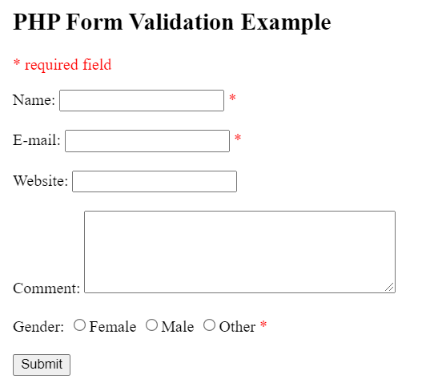
Form Validation
Proper validation of form data is important to protect your form from hackers and spammers!
The HTML form we will be working at in these chapters, contains various input fields: required and optional text fields, radio buttons, and a submit button:

Slide 57
HTML code for the form:
Text Fields
The name, email, and website fields are text input elements, and the comment field is a textarea. The HTML code looks like this:
Name: <input type="text" name="name">
E-mail: <input type="text" name="email">
Website: <input type="text" name="website">
Comment: <textarea name="comment" rows="5" cols="40"></textarea>
Radio Buttons
The gender fields are radio buttons and the HTML code looks like this:
Gender:
<input type="radio" name="gender" value="female">Female
<input type="radio" name="gender" value="male">Male
<input type="radio" name="gender" value="other">Other

Slide 58
The Form Element
The HTML code of the form looks like this:
<form method="post" action="<?php echo htmlspecialchars($_SERVER["PHP_SELF"]);?>">
When the form is submitted, the form data is sent with method="post".
What is the $_SERVER["PHP_SELF"] variable?
The $_SERVER["PHP_SELF"] is a super global variable that returns the filename of the currently executing script.
So, the $_SERVER["PHP_SELF"] sends the submitted form data to the page itself, instead of jumping to a different page. This way, the user will get error messages on the same page as the form.

Slide 59
What is the htmlspecialchars() function?
The htmlspecialchars() function converts special characters to HTML entities. This means that it will replace HTML characters like < and > with &lt; and &gt;. This prevents attackers from exploiting the code by injecting HTML or Javascript code (Cross-site Scripting attacks) in forms.
The validation rules for the form above are as follows:
Field Validation Rules
Name - Required. + Must only contain letters and whitespace
E-mail - Required. + Must contain a valid email address (with @ and .)
Website - Optional. If present, it must contain a valid URL
Comment - Optional. Multi-line input field (textarea)
Gender - Required. Must select one

Slide 60
<?php
// define variables and set to empty values
$nameErr = $emailErr = $genderErr = $websiteErr = "";
$name = $email = $gender = $comment = $website = "";
if ($_SERVER["REQUEST_METHOD"] == "POST") {
if (empty($_POST["name"])) {
$nameErr = "Name is required";
} else {
$name = test_input($_POST["name"]);
}
if (empty($_POST["email"])) {
$emailErr = "Email is required";
} else {
$email = test_input($_POST["email"]);
}

Slide 61
if (empty($_POST["website"])) {
$website = "";
} else {
$website = test_input($_POST["website"]);
}
if (empty($_POST["comment"])) {
$comment = "";
} else {
$comment = test_input($_POST["comment"]);
}
if (empty($_POST["gender"])) {
$genderErr = "Gender is required";
} else {
$gender = test_input($_POST["gender"]);
}
}
?>

Slide 62
PHP - Display The Error Messages
Then in the HTML form, we add a little script after each required field, which generates the correct error message if needed (that is if the user tries to submit the form without filling out the required fields):
Example:
<form method="post" action="<?php echo htmlspecialchars($_SERVER["PHP_SELF"]);?>">
Name: <input type="text" name="name">
<span class="error">* <?php echo $nameErr;?></span>
<br><br>

Slide 63
E-mail:
<input type="text" name="email">
<span class="error">* <?php echo $emailErr;?></span>
<br><br>
Website:
<input type="text" name="website">
<span class="error"><?php echo $websiteErr;?></span>
<br><br>
Comment: <textarea name="comment" rows="5" cols="40"></textarea>
<br><br>
Gender:
<input type="radio" name="gender" value="female">Female
<input type="radio" name="gender" value="male">Male
<input type="radio" name="gender" value="other">Other
<span class="error">* <?php echo $genderErr;?></span>
<br><br>
<input type="submit" name="submit" value="Submit">
</form>

Slide 64
PHP Forms - Validate E-mail and URL
PHP - Validate Name
The code below shows a simple way to check if the name field only contains letters, dashes, apostrophes and whitespaces. If the value of the name field is not valid, then store an error message:
$name = test_input($_POST["name"]);
if (!preg_match("/^[a-zA-Z-' ]*$/",$name)) {
$nameErr = "Only letters and white space allowed";
}
The preg_match() function searches a string for pattern, returning true if the pattern exists, and false otherwise.

Slide 65
PHP - Validate E-mail
The easiest and safest way to check whether an email address is well-formed is to use PHP's filter_var() function.
In the code below, if the e-mail address is not well-formed, then store an error message:
$email = test_input($_POST["email"]);
if (!filter_var($email, FILTER_VALIDATE_EMAIL)) {
$emailErr = "Invalid email format";
}
PHP - Validate URL
The code below shows a way to check if a URL address syntax is valid (this regular expression also allows dashes in the URL). If the URL address syntax is not valid, then store an error message:
$website = test_input($_POST["website"]);
if (!preg_match("/\b(?:(?:https?|ftp):\/\/|www\.)[-a-z0-9+&@#\/%?=~_|!:,.;]*[-a-z0-9+&@#\/%=~_|]/i",$website)) {
$websiteErr = "Invalid URL";
}

Slide 66
PHP - Validate Name, E-mail, and URL
Now, the script looks like this:
Example
<?php
// define variables and set to empty values
$nameErr = $emailErr = $genderErr = $websiteErr = "";
$name = $email = $gender = $comment = $website = "";
if ($_SERVER["REQUEST_METHOD"] == "POST") {
if (empty($_POST["name"])) {
$nameErr = "Name is required";
} else {
$name = test_input($_POST["name"]);
// check if name only contains letters and whitespace
if (!preg_match("/^[a-zA-Z-' ]*$/",$name)) {
$nameErr = "Only letters and white space allowed";
}
}

Slide 67
if (empty($_POST["email"])) {
$emailErr = "Email is required";
} else {
$email = test_input($_POST["email"]);
// check if e-mail address is well-formed
if (!filter_var($email, FILTER_VALIDATE_EMAIL)) {
$emailErr = "Invalid email format";
}
}

Slide 68
if (empty($_POST["comment"])) {
$comment = "";
} else {
$comment = test_input($_POST["comment"]);
}
if (empty($_POST["gender"])) {
$genderErr = "Gender is required";
} else {
$gender = test_input($_POST["gender"]);
}
}
?>
if (empty($_POST["website"])) {
$website = "";
} else {
$website = test_input($_POST["website"]);
// check if URL address syntax is valid (this regular expression also allows dashes in the URL)
if (!preg_match("/\b(?:(?:https?|ftp):\/\/|www\.)[-a-z0-9+&@#\/%?=~_|!:,.;]*[-a-z0-9+&@#\/%=~_|]/i",$website)) {
$websiteErr = "Invalid URL";
}
}

Slide 69
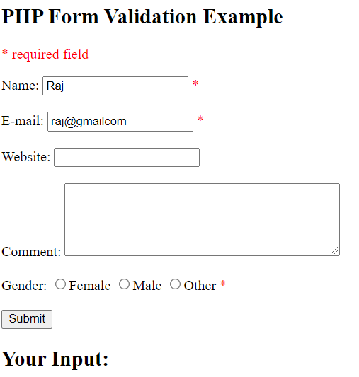
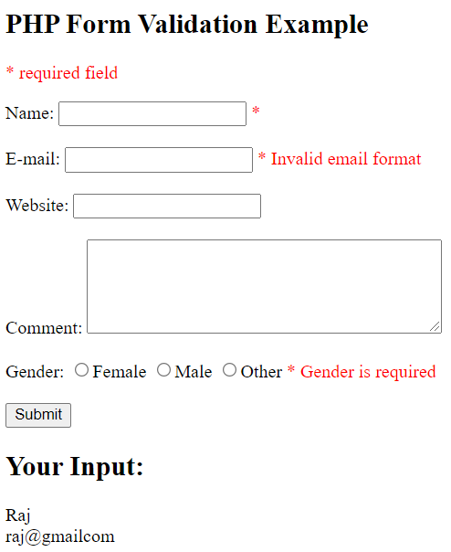
Result:
After hitting the Submit button, the error message will be generated in the form output like this,

Slide 70
PHP File Handling
File handling is an important part of any web application. You often need to open and process a file for different tasks.
PHP Manipulating Files
PHP has several functions for creating, reading, uploading, and editing files.
Note: When you are manipulating files you must be very careful. You can do a lot of damage if you do something wrong. Common errors are: editing the wrong file, filling a hard-drive with garbage data, and deleting the content of a file by accident.

Slide 71
PHP readfile() Function
The readfile() function reads a file and writes it to the output buffer.
The readfile() function is useful if all you want to do is open up a file and read its contents.
Assume we have a text file called "webdictionary.txt", stored on the server, that looks like this:
AJAX = Asynchronous JavaScript and XML
CSS = Cascading Style Sheets
HTML = Hyper Text Markup Language
PHP = PHP Hypertext Preprocessor
SQL = Structured Query Language
SVG = Scalable Vector Graphics
XML = EXtensible Markup Language

Slide 72
The PHP code to read the file and write it to the output buffer is as follows (the readfile() function returns the number of bytes read on success):
Example
<?php
echo readfile("webdictionary.txt");
?>
Result:
AJAX = Asynchronous JavaScript and XML CSS = Cascading Style Sheets HTML = Hyper Text Markup Language PHP = PHP Hypertext Preprocessor SQL = Structured Query Language SVG = Scalable Vector Graphics XML = EXtensible Markup Language236

Slide 73
PHP File Open/Read/Close
PHP Open File - fopen()
A better method to open files is with the fopen() function. This function gives you more options than the readfile() function.
The first parameter of fopen() contains the name of the file to be opened and the second parameter specifies in which mode the file should be opened. The following example also generates a message if the fopen() function is unable to open the specified file:
PHP Read File - fread()
The fread() function reads from an open file. The first parameter of fread() contains the name of the file to read from and the second parameter specifies the maximum number of bytes to read.
The following PHP code reads the "webdictionary.txt" file to the end:
fread($myfile,filesize("webdictionary.txt"));

Slide 74
PHP Close File - fclose()
The fclose() function is used to close an open file. It's a good programming practice to close all files after finished with them. You don't want an open file running around on your server taking up resources!
The fclose() requires the name of the file (or a variable that holds the filename) we want to close:
Example:
<?php
$myfile = fopen("webdictionary.txt", "r") or die("Unable to open file!");
echo fread($myfile,filesize("webdictionary.txt"));
fclose($myfile);
?>
Result:
AJAX = Asynchronous JavaScript and XML CSS = Cascading Style Sheets HTML = Hyper Text Markup Language PHP = PHP Hypertext Preprocessor SQL = Structured Query Language SVG = Scalable Vector Graphics XML = EXtensible Markup Language

Slide 75
PHP Read Single Line - fgets()
The fgets() function is used to read a single line from a file. The example below outputs the first line of the "webdictionary.txt" file:
Example:
<?php
$myfile = fopen("webdictionary.txt", "r") or die("Unable to open file!");
echo fgets($myfile);
fclose($myfile);
?>
Result:
AJAX = Asynchronous JavaScript and XML
Note: After a call to the fgets() function, the file pointer has moved to the next line.

Slide 76
PHP Check End-Of-File - feof()
The feof() function checks if the "end-of-file" (EOF) has been reached. The feof() function is useful for looping through data of unknown length. The example below reads the "webdictionary.txt" file line by line, until end-of-file is reached:
Example:
<?php
$myfile = fopen("webdictionary.txt", "r") or die("Unable to open file!");
// Output one line until end-of-file
while(!feof($myfile)) {
echo fgets($myfile) . "<br>";
}
fclose($myfile);
?>

Slide 77
Cookies and Sessions

Slide 78
Need for Cookies and Sessions
HTTP is a stateless protocol
This means that each request is handled independently of all the other requests and it means that a server or a script cannot remember if a user has been there before
However, knowing if a user has been there before is often required and therefore something known as cookies and sessions have been implemented

Slide 79
Similarity between Cookies and Sessions
Different mechanisms of the same solution
Cookies
A mechanism for storing data in the remote browser and thus tracking or identifying return users
Sessions
It is support in PHP consists of a way to preserve certain data across subsequent accesses. This enables you to build more customized applications and increase the appeal of your web site.

Slide 80
What is a Cookie?
A cookie is a piece of text that a Web server can store on a users hard disk
A cookie is a variable, sent by the server to the browser
Cookies allow a Web site to store information on a users machine and later retrieve it. The pieces of information are stored as name-value pairs
With PHP, one can both create and retrieve cookie values

Slide 81
What is a Cookie?
Each cookie on the user’s computer is connected to a particular domain
Each time the same computer requests a page with a browser, it will send the cookie too
Each cookie can store up to 4kB of data
A maximum of 20 cookies can be stored on a user’s PC per domain

Slide 82



When are Cookies Created?
When a new webpage is loaded
If the user has elected to disable cookies then the write operation will fail, and subsequent sites which rely on the cookie will either have to take a default action
Example (1) User sends a request for page at www.example.com for the first time. page request
Example (2) Server sends back the page html to the browser AND stores some data in a cookie on the user’s PC. html cookie data
Example (3) At the next page request for domain www.example.com, all cookie data associated with this domain is sent too. page request cookie data

Slide 83
Parts of a Cookie
Each cookie is effectively a small lookup table containing pairs of (key, data) values - for example (firstname, John) (lastname,Peter)
Once the cookie has been read by the code on the server or client computer, the data can be retrieved and used to customise the web page appropriately

Slide 84
Syntax for setting up a cookie
setcookie(name [,value [,expire [,path [,domain [,secure]]]]])
name = cookie
namevalue = data to store (string)
expire = UNIX timestamp when the cookie expires. Default is that cookie expires when browser is closed.
path = Path on the server within and below which the cookie is available on.
domain = Domain at which the cookie is available for.
secure = If cookie should be sent over HTTPS connection only. Default false.

Slide 85
Examples for setcookie
setcookie(‘name’,’Robert’)
This command will set the cookie called name on the user’s PC containing the data Robert. It will be available to all pages in the same directory or subdirectory of the page that set it (the default path and domain). It will expire and be deleted when the browser is closed (default expire)

Slide 86
Examples for setcookie
setcookie(‘age’,’20’,time()+60*60*24*30)
This command will set the cookie called age on the user’s PC containing the data 20. It will be available to all pages in the same directory or subdirectory of the page that set it (the default path and domain). It will expire and be deleted after 30 days.

Slide 87
Examples for setcookie
setcookie(‘gender’,’male’,0,’/’)
This command will set the cookie called gender on the user’s PC containing the data male. It will be available within the entire domain that set it. It will expire and be deleted when the browser is closed.

Slide 88
Read cookie data
All cookie data is available through the superglobal
$_COOKIE:
$variable = $_COOKIE[‘cookie_name’] or
$variable = $HTTP_COOKIE_VARS[‘cookie_name’];
Example: $age = $_COOKIE[‘age’]

Slide 89
Delete a cookie
To remove a cookie, simply overwrite the cookie with a new one with an expiry time in the past
setcookie(‘cookie_name’,’’,time()-6000)
Note that theoretically any number taken away from the time() function should do, but due to variations in local computer times, it is advisable to use a day or two.

Slide 90
Problems with Cookies
Browsers can refuse to accept cookies
Additionally, it adds network overhead to send lots of information back and forth.
There are also limits to the amount of information that can be sent
Some information you just don’t want to save on the client’s computer.

Slide 91
Sessions
A Session allows to store user information on the server for later use (i.e. username, shopping cart items, etc)
However, this session information is temporary and is usually deleted very quickly after the user has left the website that uses sessions
Session variables hold information about one single user, and are available to all pages in one application.

Slide 92
Starting a PHP Session
Before you can store user information in your PHP session, you must first start up the session
The session_start() function must appear BEFORE the <html> tag.
<?php session_start(); ?>
<html>
<body>
..
..
</body>
</html>

Slide 93
Storing a Session Variable
The $_SESSION variable can be store and retrieved in PHP
<?php
session_start();
// store session data
$_SESSION[views]=1;
?>
<html>
<body
</body>
</html>

Slide 94
Retrieving a Session Variable
<html>
<body>
<?php
//retrieve session data
echo "Pageviews=". $_SESSION[views];
?>
</body>
</html>
Display:
Pageviews = 1

Slide 95
Destroying a Session
The unset() function is used to free the specified session variable.
<?php
unset($_SESSION[views]);
?>
You can also completely destroy the session by calling the session_destroy() function:
<?php
session_destroy();
?>
session_destroy() will reset your session and you will lose all your stored session data.

Slide 96
Cookies vs. Sessions
Cookies
Sessions
Cookies are stored on client side
Cookies can only store strings
Cookies can be set to a long lifespan
Sessions are stored on server
Sessions can store objects
When users close their browser, lifespan. they also lost the session

Slide 97
Filters- Introduction
PHP Filter is an extension that filters the data by either sanitizing or validating it
It plays a crucial role in security of a website, especially useful when the data originates from unknown or foreign sources, like user supplied input
For example data from a TML form
There are mainly two types of filters
1. Validation
2. Sanitization

Slide 98
Types of filters
Validation
Used to validate or check if the data meets certain qualifications or not
Example: passing in FILTER_VALIDATE_URL will determine if the data is a valid url, but it will not change the existing data by itself
Sanitization
Unlike validation, sanitization will sanitize data so as to ensure that no undesired characters by removing or altering the data
Example passing in FILTER_SANITIZE_EMAIL will remove all the characters that are inappropriate for an email address to contain. That said, it does not validate the data

Slide 99
Example PHP program to validate
Program to validate URL using FILTER_VALIDATE_URL filter
Program to validate email using FILTER_VALIDATE_EMAIL filter
<?php
// PHP program to validate email
// Declare variable and initialize it to email
$email = "xyz@gmail.com";
// Use filter function to validate email
if (filter_var($email, FILTER_VALIDATE_EMAIL)) {
echo "Valid Email";
}
else {
echo "Invalid Email";
}
?>
<?php
// PHP program to validate URL
// Declare variable and initialize it to URL
$url = "https://www.geeksforgeeks.org";
// Use filter function to validate URL
if (filter_var($url, FILTER_VALIDATE_URL)) {
echo("valid URL");
}
else {
echo("Invalid URL");
}
?>

Slide 100
Filter Functions
The filter function is used to filter the data coming from insecure source
filter_var(): Filters a specific variable
filter_var_array():Filters multiple variable i.e. array of variable
filter_has_var(): Check if the variable of specific input type exists or not
filter_id():helps to get filter id of the specified filter name
filter_list():Returns a list of supported filter name in the form of array
filter_input():Gets an external variable and filters it if set to do so
filter_input_array():same as filter_input() but here Gets multiple variables i.e. array of variable and filters them if set to do so

Slide 101
Predefined Filter Constants
Validate filter constants
FILTER_VALIDATE_BOOLEAN: Validates a boolean
FILTER_VALIDATE_INT: Validates an integer
FILTER_VALIDATE_FLOAT: Validates a float
FILTER_VALIDATE_REGEXP: Validates a regular expression
FILTER_VALIDATE_IP: Validates an IP address
FILTER_VALIDATE_EMAIL: Validates an e-mail address
FILTER_VALIDATE_URL: Validates an URL

Slide 102
Predefined Filter Constants
Sanitize filter constants
FILTER_SANITIZE_EMAIL: Removes all illegal characters from an e-mail address
FILTER_SANITIZE_ENCODED: Removes/Encodes special characters
FILTER_SANITIZE_MAGIC_QUOTES: Apply addslashes() function
FILTER_SANITIZE_NUMBER_FLOAT: Remove all characters, except digits, +- and optionally ., eE
FILTER_SANITIZE_NUMBER_INT: Removes all characters except digits and + –
FILTER_SANITIZE_SPECIAL_CHARS: Removes special characters
FILTER_SANITIZE_FULL_SPECIAL_CHARS Encoding quotes can be disabled by using FILTER_FLAG_NO_ENCODE_QUOTES.
FILTER_SANITIZE_STRING : Removes tags/special characters from a string
FILTER_SANITIZE_STRIPPED : Alias of FILTER_SANITIZE_STRING
FILTER_SANITIZE_URL: Removes all illegal character from s URL

Slide 103
Predefined Filter Constants
Other filter constants
FILTER_UNSAFE_RAW :Do nothing, optionally strip/encode special characters
FILTER_CALLBACK :Call a user-defined function to filter data

Slide 104
Exception Handling in PHP
An exception is unexpected program result that can be handled by the program itself. Exception Handling in PHP is almost similar to exception handling in all programming languages
PHP provides following specialized keywords for this purpose
try: It represent block of code in which exception can arise
catch: It represent block of code that will be executed when a particular exception has been thrown
throw: It is used to throw an exception. It is also used to list the exceptions that a function throws, but doesn’t handle itself
finally: It is used in place of catch block or after catch block basically it is put for cleanup activity in PHP code

Slide 105
Need for Exception Handling in PHP
Following are the main advantages of exception handling over error handling
Separation of error handling code from normal code: In traditional error handling code there is always if else block to handle errors. These conditions and code to handle errors got mixed so that becomes unreadable. With try Catch block code becomes readable
Grouping of error types: In PHP both basic types and objects can be thrown as exception. It can create a hierarchy of exception objects, group exceptions in namespaces or classes, categorize them according to types

Slide 106
Exception handling in PHP
<?php
// PHP Program to illustrate normal
// try catch block code
function demo($var) {
echo " Before try block";
try {
echo "\n Inside try block";
// If var is zero then only if will be executed
if($var == 0)
{
// If var is zero then only exception is thrown
throw new Exception('Number is zero.');
// This line will never be executed
echo "\n After throw (It will never be executed)";
}
}
// Catch block will be executed only
// When Exception has been thrown by try block
catch(Exception $e) {
echo "\n Exception Caught", $e->getMessage();
}
// This line will be executed whether
// Exception has been thrown or not
echo "\n After catch (will be always executed)";
}
// Exception will not be rised
demo(5);
// Exception will be rised here
demo(0);
?>
Output
Before try block Inside try block After catch (will be always executed) Before try block Inside try block Exception CaughtNumber is zero. After catch (will be always executed)

Slide 107
Using Custom Exception Class
<?php
class myException extends Exception {
function get_Message() {
// Error message
$errorMsg = 'Error on line '.$this->getLine().
' in '.$this->getFile()
.$this->getMessage().' is number zero';
return $errorMsg;
}
}
function demo($a) {
try {
// Check if
if($a == 0) {
throw new myException($a);
}
}
catch (myException $e) {
// Display custom message
echo $e->get_Message();
}
}
// This will not generate any exception
demo(5);
// It will cause an exception
demo(0);
?>
Output
Error on line 20 in /home/45ae8dc582d50df2790517e912980806.php0 is number zero

Slide 108
Set a Top Level Exception Handler
The set_exception_handler() function set all user defined function to all uncaught exception
Example
<?php function exception_handler($exception) { echo "Uncaught exception: " , $exception->getMessage(), "\n"; } set_exception_handler('exception_handler'); throw new Exception('Uncaught Exception'); echo "Not Executed\n"; ?>

Slide 109

Database Connectivity With MySQL

Slide 110
BASIC DATABASE SERVER CONCEPTSBASIC DATABASE SERVER CONCEPTS
world's most popular open source database because of its consistent fast performance, high reliability and ease of use

Slide 111
BASIC DATABASE SERVER CONCEPTSBASIC
Database runs as a server Attaches to either a default port or an administrator specified port Clients connect to database For secure systems authenticated connections usernames and passwords Clients make queries on the database Retrieve content Insert content SQL (Structured Query Language) is the language used to insert and retrieve content

Slide 112
MY SQL
MySQL can be controlled through a simple command-line interface; however, we can use phpMyAdmin as an interface to MySQL
phpMyAdmin is a very powerful tool; it provides a large number of facilities for customising a database management system

Slide 113
CONNECTING to MY SQL
In order for our PHP script to access a database we need to form a connection from the script to the database management system
resourceId = mysql_connect(server, username, password);
Server is the DBMS server
username is your username password is your password

Slide 114
CONNECTING to MY SQL DBMS
In order for our PHP script to access a database we need to form a connection from the script to the database management system
resourceId = mysql_connect(server, username, password);
The function returns a resource-identifier type
• a PHP script can connect to a DBMS anywhere in the world, so long as it is connected to the internet
• We can also connect to multiple DBMS at the same time

Slide 115
SELECTING A DATABASE
Once connected to a DBMS, we can select a database
mysql_select_db(databasename, resourceId);

Slide 116
Create HTML form for connecting to database
you need to create a working folder first and then create a web page with the name “contact.html”
If you install xampp your working folder is in folder this “E:\xampp\htdocs”
You can create a new folder “contact” on your localhost working folder
Create a “contact.html” file and paste the following code

Slide 117
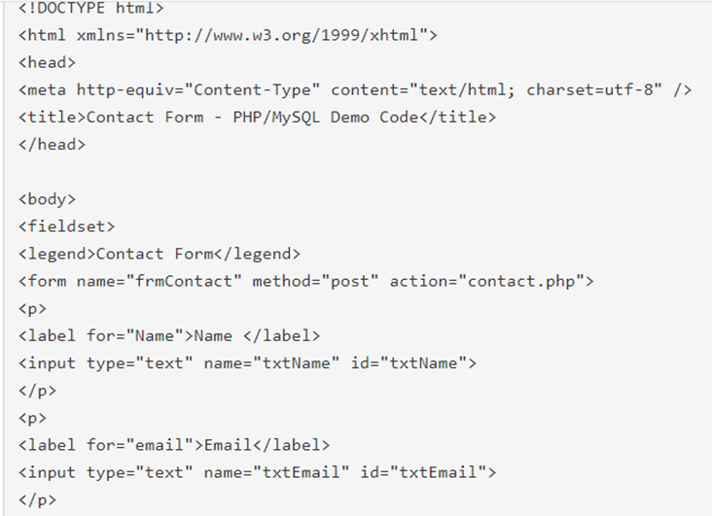
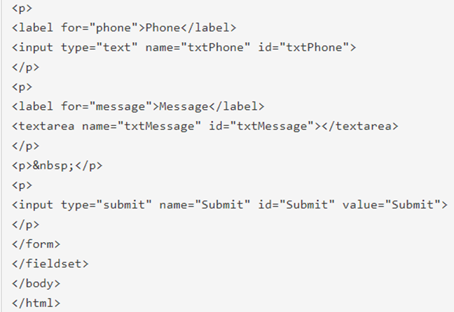
Code create HTML form for connecting to database

Slide 118
Create a PHP page to save data from HTML form to your MySQL database
The contact HTML form action is on “contact.php” page. On this page, we will write code for inserting records into the database.
For storing data in MySQL as records, you have to first connect with the DB. Connecting the code is very simple. The mysql_connect in PHP is
mysqli_connect.
Example:
$con = mysqli_connect("localhost","your_localhost_database_user",
"your_localhost_database_password","your_localhost_database_db");

Slide 119
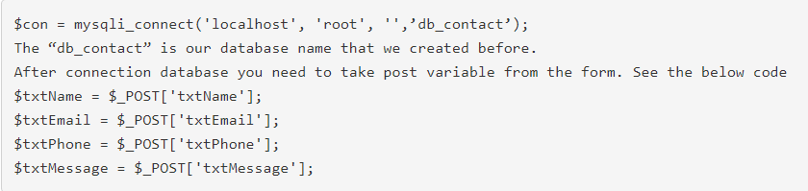
Local Host
You need to place value for your localhost username and password. Normally localhost MySQL database username is root and password blank or root
Example

